Slide 1
VLF TTE communication
Lior Kissos
Supervised by Prof. Moshe Nazarathy
Technion EE Department

Slide 2
Thanks
Alex Tolmachev
Yuval Ben Hur
Nikolay Tal

Slide 3
Background

Slide 4
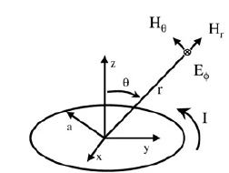
Magneto Quasi Static NF communication- Principles
Magnetic radiator:
galvanic current loop fields
Near field:
Quasi static:
Notes:
NF וקוואזי סטטי בת"ל לכאורה, אך למעשה הקווזי סטטיקה הופכת את ה-NF לאזור מעשי לעבודה
High-Speed Digital System
Design—A Handbook of
Interconnect Theory and Design
Practices
p.209-235

Slide 5
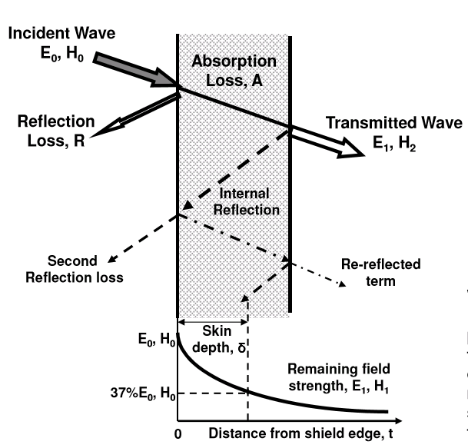
Magnetic Radiator - Near Fields and Medium Reflection
Magnetic Radiator Near Fields:
Near field Wave Impedance:
Reflection from conductor
We need low Zwave!

Slide 6
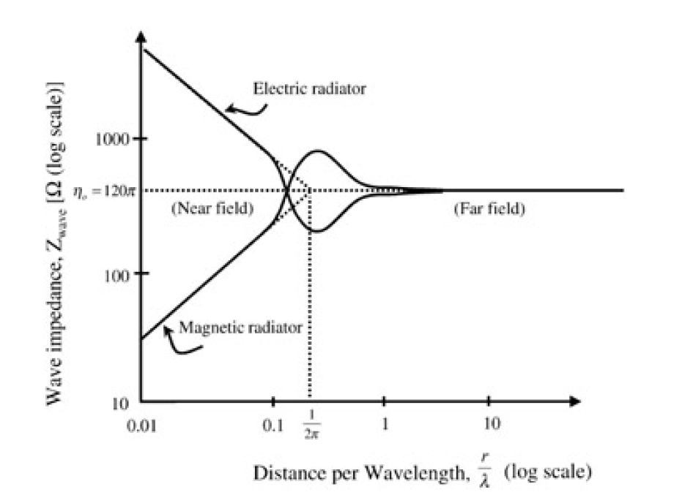
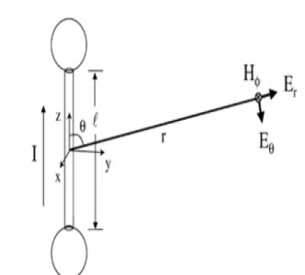
Quasi static & Magnetic radiator Near Fields
Quasi Static
Notes:
1) משטר קווזי סטטי: קיים קשר חלש בין מגנטי לחשמלי. ניתן לנסחו במונחי אימפדנס. קשר חלש= אימפדנס גבוה מאוד או נמוך מאוד
המשטר הקווזי סטטי פשוט הופך מרחקים של עשרות מטרים לכאלה שבהם מתקיים שדה קרוב. אם הקורן הוא מגנטי, אזי ניתן להגיע לאימפדנסים מאוד נמוכים ביחס למוליכים. מוליך טוב בעל אימפדנס של 1e-8
High-Speed Digital System
Design—A Handbook of
Interconnect Theory and Design
Practices
Stephen Hall

Slide 7
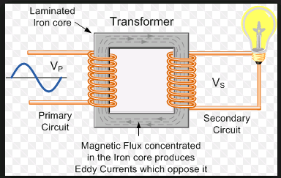
Signal Transfer
Receiver
Transmitter

Slide 8
Summary
Current loop is a good magnetic radiator
Quasi static regime (~10kHz) assures:
near field behavior beyond 1000 m (irrelevant further away)
Very low wave impedance, thus insensitive to conductive mediums (soil is conductive)
Near field & magnetic radiator:
H dominance
Power follows , thus relevant only to 10’s of meters

Slide 9
Utilizations & Operational systems
Civilian: Mining emergency
HLS: First responders inside urban ruins
Military: Sub terrain hostile infiltration tunnels investigation
Current systems performance
Data: text, voice
Range: 50 to 600 meters

Slide 10
Project- System view

Slide 11
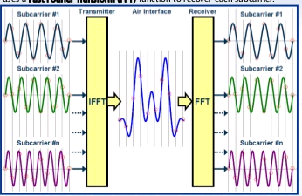
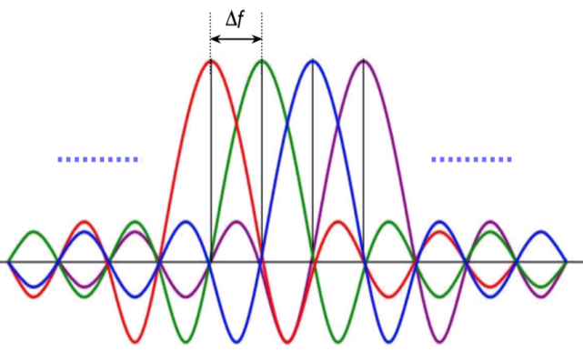
General
Goal: demonstration setup of magneto quasi static communication system, based on the OFDM technique

Slide 12
Why OFDM?
It is channel minded and the channel has not been investigated sufficiently:
Equalization:
Frequency selective :tradeoffs better difficult (=dispersive) channels
Low complexity and easy implementation
Possibility of frequency selective allocations: power, modulation, coding etc.
Natural MIMO integration (namely diversity)
Main drawback : PAPR

Slide 13
Link
BW (=Fchip)=10kHz
Fif=10kHz
Frec=100ksps
Tx
OFDM
Tx
IF
D/A
&
Rec. Filter
Channel
A/D
&
AA Filter
Rx
IF
Rx
OFDM
Fs=100ksps

Slide 14
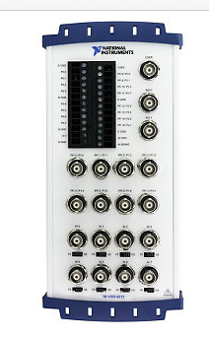
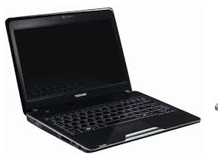

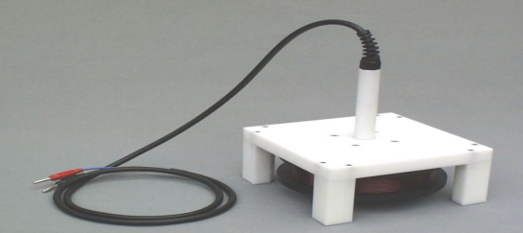
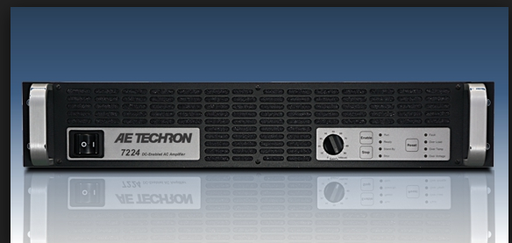
Tx Chain
D/A
Tx
OFDM
Tx
IF
Coil
Amplifier

Slide 15
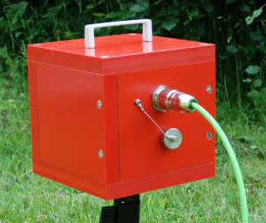
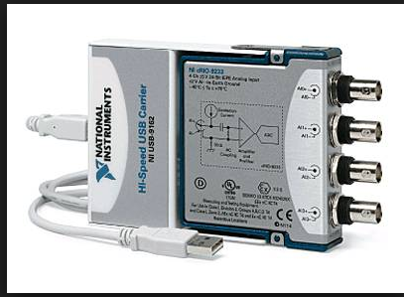
Rx Chain
Sensor
A/D
Tx
OFDM
Tx
IF

Slide 16
OFDM

Slide 17
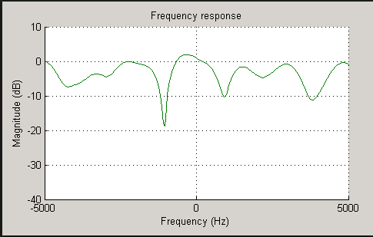
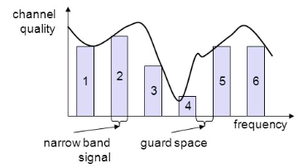
OFDM evolution
Frequency selective channel
Serial
Single carrier
wideband signal:
Short time domain
duration
Parallel
narrow band signals:
Long time duration
(longer than delay spread)

Slide 18
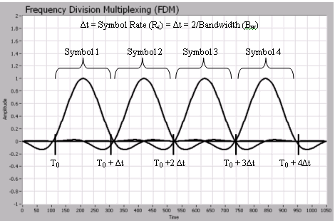
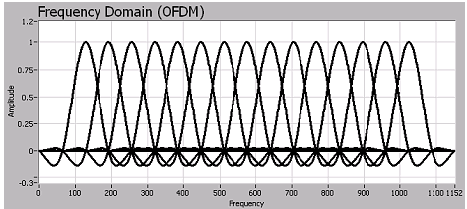
OFDM evolution
FDM multicarrier:
Better handling of
Selective channels
OFDM: “Analog”-
Better spectral efficiency
OFDM: “Digital”-
Reduced complexity of
modulation (FFT),
channel estimation (CP) ,
And equalization

Slide 19
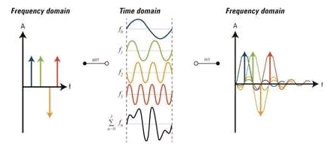
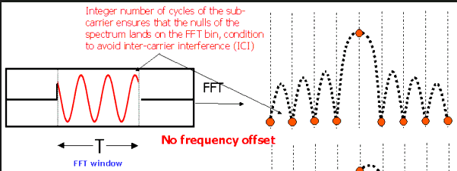
OFDM: Time Vs. Frequency
T>delay spread
2/T

Slide 20
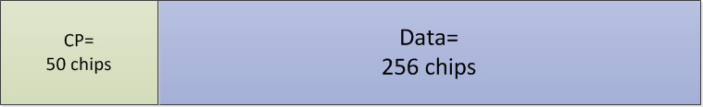
Time Domain: Symbol
Tchip:
Amplifier band=[0,20]kHz
Fif=10kHz
=> Fchip=10kHz⬄Tchip=0.1msec
Nfft & Ncp:
Tchannel~1msec
Tchip=0.1msec
=>Nchannel=10
=>Ncp=50 (>Nchannel)
=>Nfft=256 (>>Nchannel,>>Ncp)
Tsymbol=
Tchip(Nfft+Ncp)=30.6msec
Notes:
NFFT מכתיב את T ולכן את ר"ס ה-SC. בלי כל קשר ל-CP נרצה שיהיה גדול מאוד מזכרון הערוץ

Slide 21
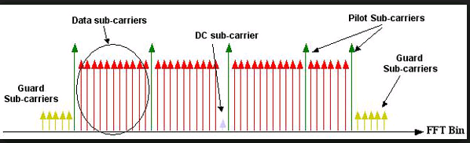
Frequency domain: Symbol
Nfft=256
Guard bands (Wimax)
Left=28
Right=27
Pilots=6
=> Ndata=256-(27+28+6+1)=200
BW gross=Fchip=10kHz
BW net= 7.8kHz

Slide 22
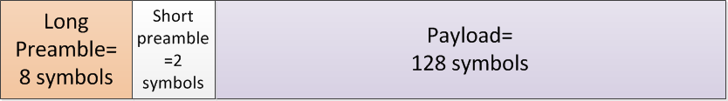
Time Domain: Frame
Long preamble:
Time synch
Carrier offset: coarse correction (ICI prevention)
Short preamble:
Channel estimation
Noise power estimation
Tframe=Tsymbol(8+2+128)=4.2sec

Slide 23
Throughput calculations
Time domain efficiency:
Symbol: Nfft/(Ncp+Nfft)=0.84
Frame: 128/(128+2+8)=0.93
Frequency domain efficiency=Ndata/Nfft=200/256=0.78
Modulation: 64QAM, thus 6bits/symbol
Coding: RS(63,43), thus rate 2/3
Throughput=

Slide 24
IF

Slide 25
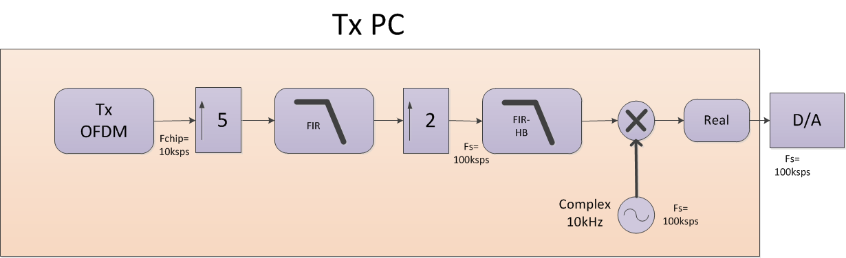
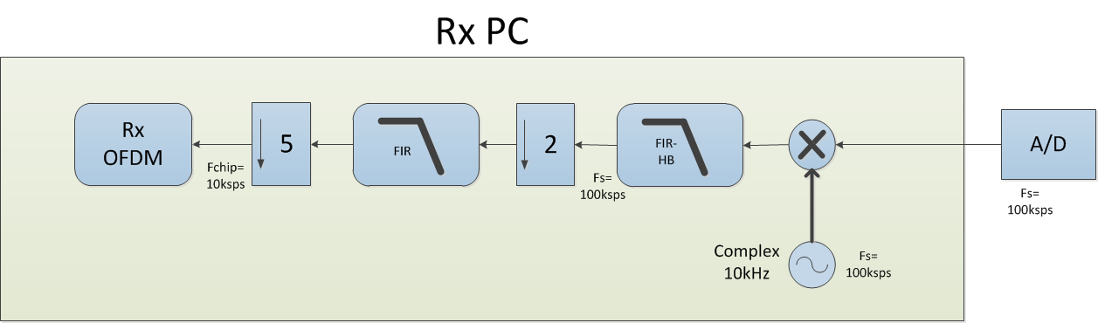
The SDR concept

Slide 26
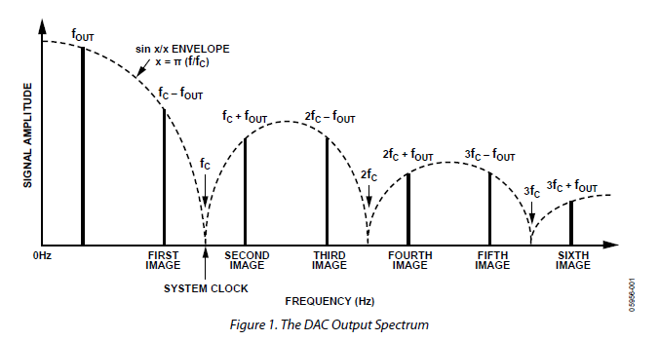
Tx pre-emphasis
Tx Loop 1/f frequency shaping
D/A Sinc frequency shaping
Inverse Sinc FIR

Slide 27
Simulations

Slide 28
Calibration: no Coding, no Equalizer

Slide 29
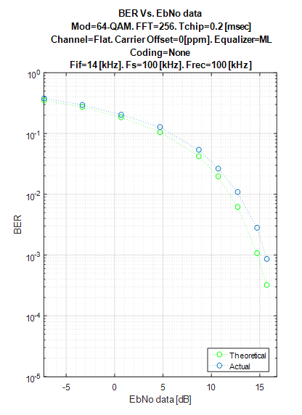
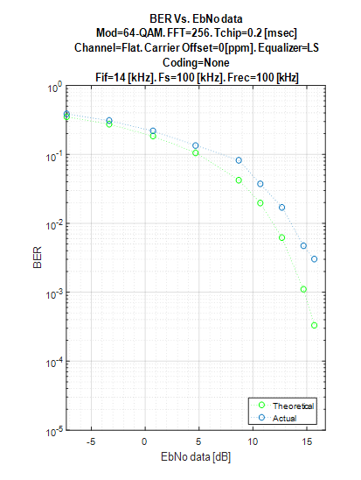
Equalizer & noise enhancement
ML
LS

Slide 30
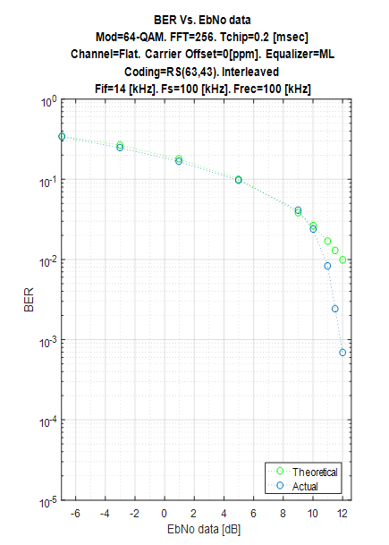
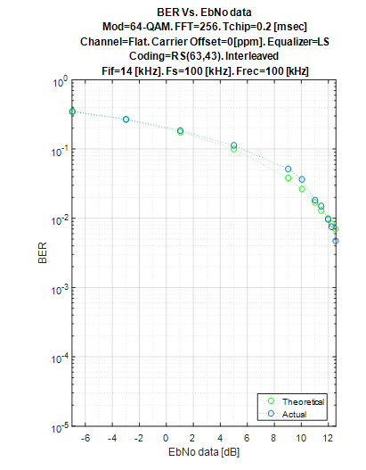
Coding: RS(63,43)
ML
LS

Slide 31
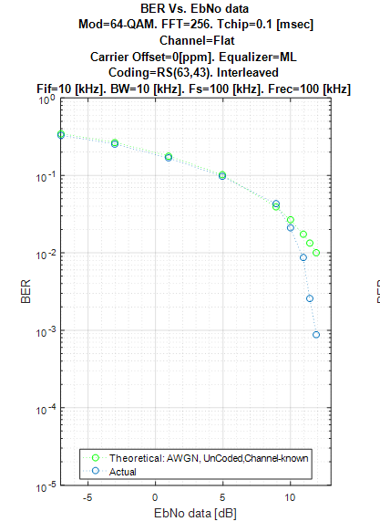
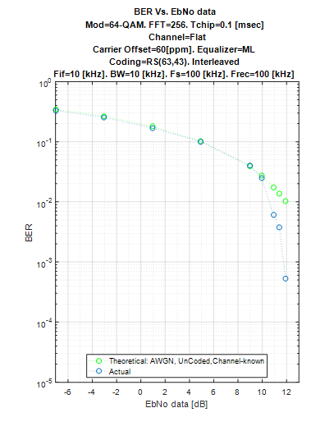
Carrier offset
Offset= 0 ppm
Offset= 60 ppm

Slide 32
Multipath
4Tchip

Slide 33
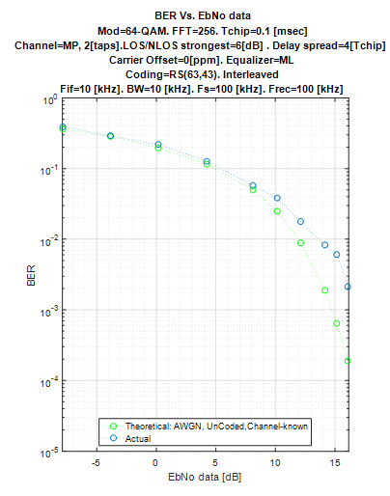
Multipath
Flat Channel
Multipath Channel

Slide 34
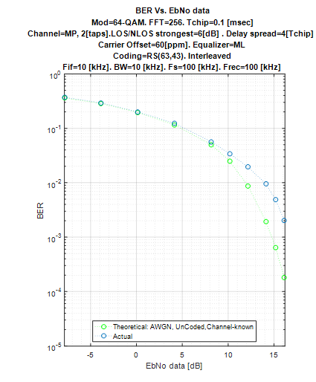
Multipath & Carrier offset
Carrier offset=60ppm
Carrier offset=0

Slide 35
HW- Back to Back

Slide 36
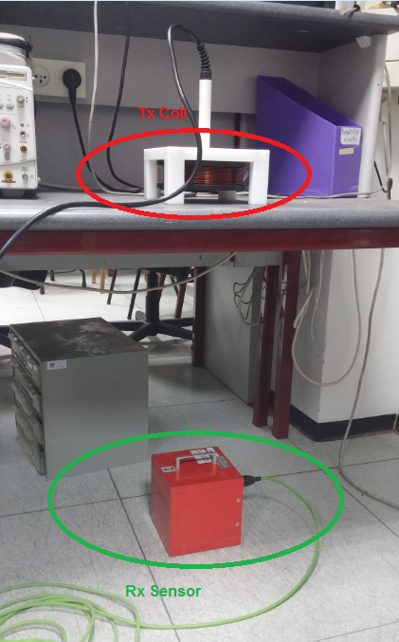
HW –Wireless channel

Slide 37
HW –Wireless channel
Wo pre-emphasis
W pre-emphasis

Slide 38
HW –Wireless channel

